Slide 1
DIRECT-PV-Systems
By: Stephanie Tarczynski, Tessa De Souza Machado, Ryan Littrell

Slide 2
Background
The “Tracking the Sun” project dataset contains locations of solar cell systems across the United States.
In order to create meaningful visualizations that are easy for the users to understand a package is needed to:
Create maps of the U.S. or specific regions of the U.S.
Advanced plotting options that enables us to correlate dataset attributes to location
A range of detailed and simplified visualizations so that we can tailor our program for the various clients

Slide 3
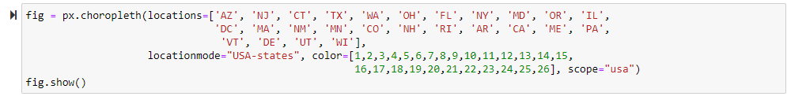
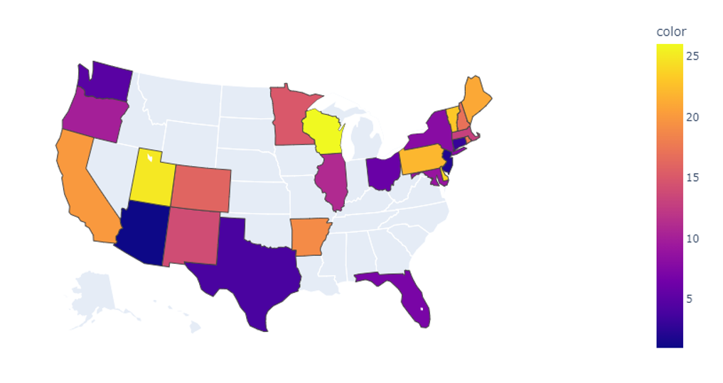
Plotly
https://plotly.com/python/
Open Source Graphing Libraries
Advantages:
Inputs are intuitive (used state abbreviation for the plot to the right)
Database of preloaded maps
Easy to use
Disadvantages:
Some paid services may not be readily available
Not as detailed locations available as Folium (next slide)

Slide 4
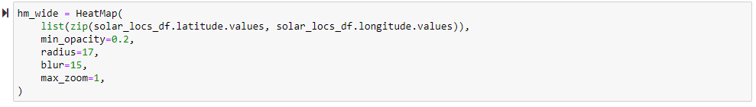
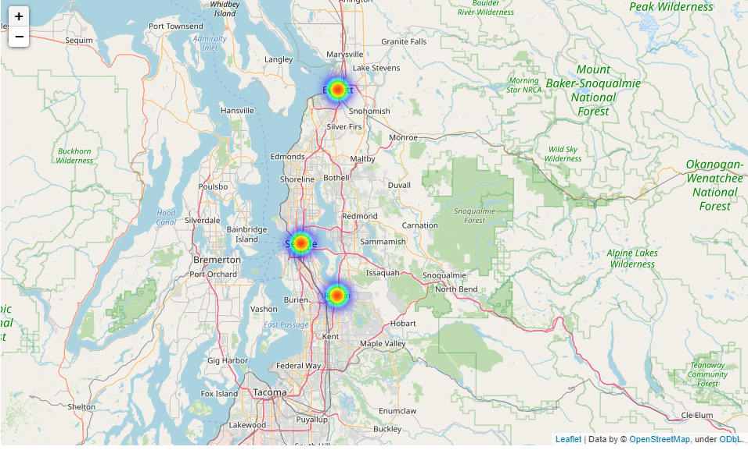
Folium
https://github.com/python-visualization/folium
Advantages:
Gives exact locations and detailed maps.
Easy to use
Disadvantages:
Needs latitude and longitude data, we are figuring out if we can convert city/zip code info to lat/long.

